Slide 1


HEP NTUA Weekly Report 2/2/2022
George Bakas

Slide 2
Summary
ttX analysis:
New UL b-tag WPs for 2016preVFP and 2016 postVFP released
Switch and implementation
p_{T}>450 GeV for leading jet and p_{T}>400 GeV for second leading jet
We are writing the AN:
Basic outline along with text
Input all images that are needed for the analysis
Appendices that include
Response matrices, efficiencies, acceptance, purity and stability per year
Fiducial Measurements per year
Systematic uncertainties breakdown per year
Closure tests
Issues are handled on gitlab
Z’ analysis:
Production for files that were missing
Integration of M1400 W14 for 2016_preVFP in analysis chain

Slide 3
Efficiency Parton Level

Slide 4
Efficiency Particle Level

Slide 5
Acceptance Parton Level

Slide 6
Acceptance Particle Level

Slide 7
Mass Fit Results 2016 (pre and postVFP)
pre
post

Slide 8
Mass Fit Results 2017, 2018
2017
2018

Slide 9
Final Results Parton

Slide 10
Final Results Particle

Slide 11
Final Results Parton

Slide 12
Final Results Particle

Slide 13
Final Results Parton

Slide 14
Final Results Particle

Slide 15
Final Results Parton

Slide 16
Final Results Particle

Slide 17
Final Results Parton

Slide 18
Final Results Particle

Slide 19
Final Results Parton

Slide 20
Final Results Particle

Slide 21
Final Results Parton

Slide 22
Final Results Particle

Slide 23
Final Results Parton

Slide 24
Final Results Particle

Slide 25
Final Results Parton

Slide 26
Final Results Particle

Slide 27
Final Results Particle

Slide 28
Final Results Particle

Slide 29
BACKUP

Slide 30
Summary
ttX analysis Pipeline Creation
We want to be able to handle all Nominal files and their variations in an automated way
This requires deciding consistent naming conventions and a efficient planning
Handling of:
Nominal
Parton Shower Weights
PDF Variations
JES
Scale Variations
bTagVariations
Top quark mass variations
Per year For all these we need to
Create template files that have 2btag and 0btag in Extended and Reduced jetMassSoftDrop phase space
9 variables (mJJ, pTJJ, yJJ, jetPt[0,1], jetY[0,1], chi, |cosTheta*|[0,1]
Template fit files (bkg qcd, bkg subdominant) and signal templates for all variations
Fit on extended signal region for all variations
Response matrices, Acceptance, Efficiency
Signal Extraction
Combine all Fiducial Level results (4 years) into 1 Extracted Signal for all variations
Unfold the combined result into Parton & Particle levels
Show systematic variations compared to the Nominal file
The same procedure must be done using different nominal files
Fill in 2btag histograms in our signal region in the parton
For each variation and each year
Combine all years together
Calculate systematics for samples other than the nominal

Slide 31
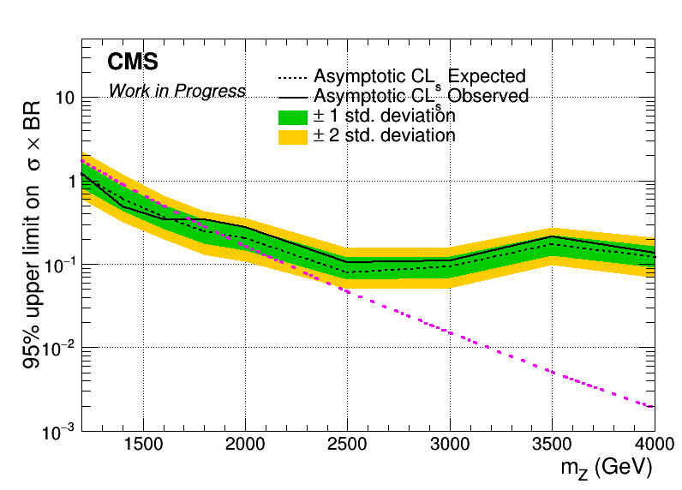
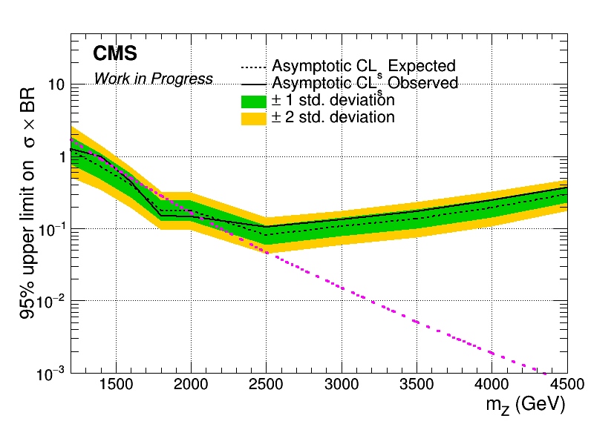
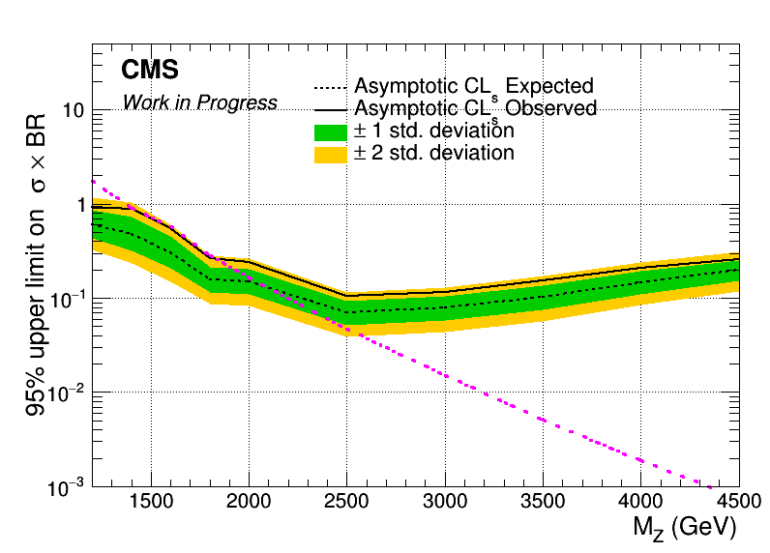
Brazilian Plots (2016_preVFP, 2017 and 2018) with sliding mJJ Cut
2016_preVFP
2017
2018

Slide 32
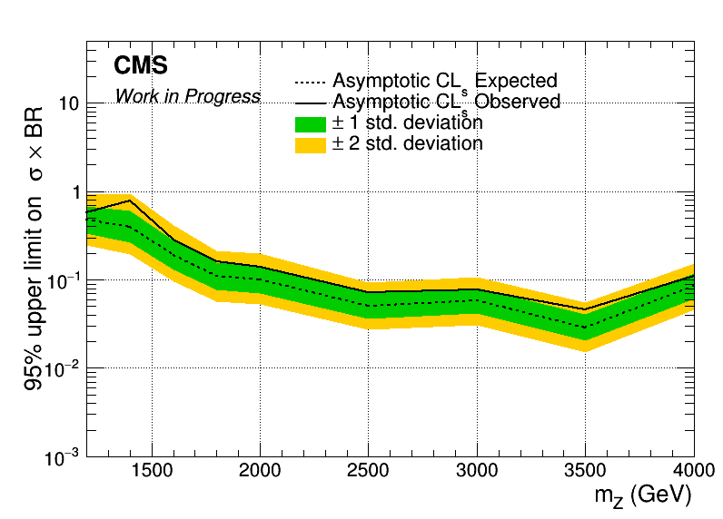
Combined Datacard for 2016_preVFP, 2017 and 2018
Mass Cut Mapping
{"mZ_1200_12":1000, "mZ_1400_14":1200, "mZ_1600_16":1400, "mZ_1800_18":1600, "mZ_2000_20":1600,
"mZ_2500_25":2000, "mZ_3000_30":2000, "mZ_3500_35":2000, "mZ_4000_40":2000, "mZ_4500_45":2000}

Slide 33
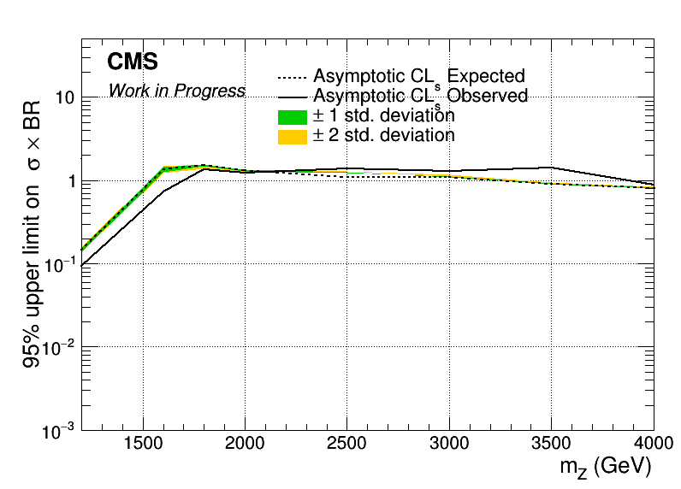
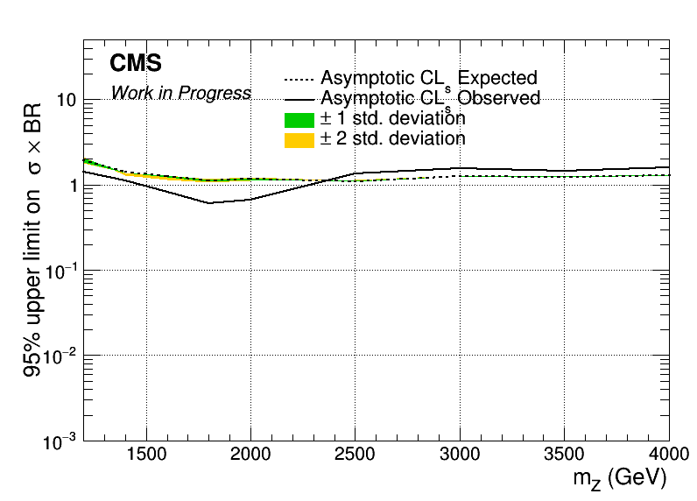

Brazilian Plots (2016_preVFP, 2017 and 2018) with sliding mJJ Cut wrt 2018
2016_preVFP
2017
2018

Slide 34
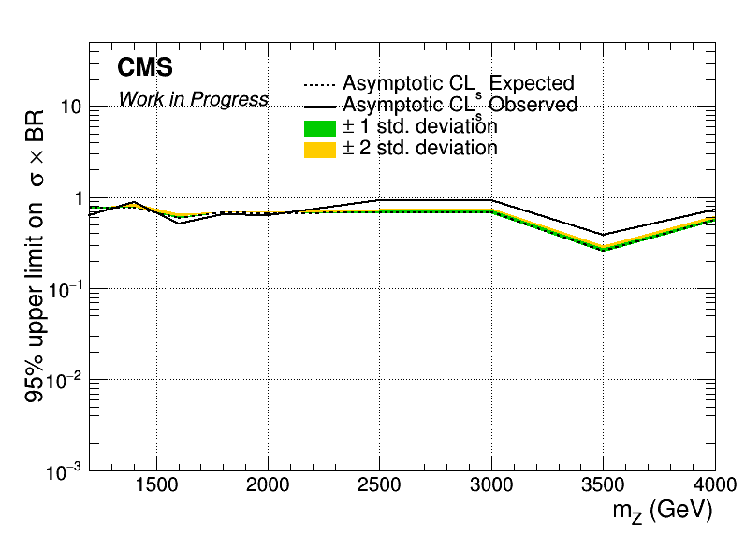
Combined Datacard for 2016_preVFP, 2017 and 2018 wrt 2018
Mass Cut Mapping
{"mZ_1200_12":1000, "mZ_1400_14":1200, "mZ_1600_16":1400, "mZ_1800_18":1600, "mZ_2000_20":1600,
"mZ_2500_25":2000, "mZ_3000_30":2000, "mZ_3500_35":2000, "mZ_4000_40":2000, "mZ_4500_45":2000}

